Slide 1
Bucharest Stock Exchange
(One of) The way(s) to success
September 2024

Slide 2
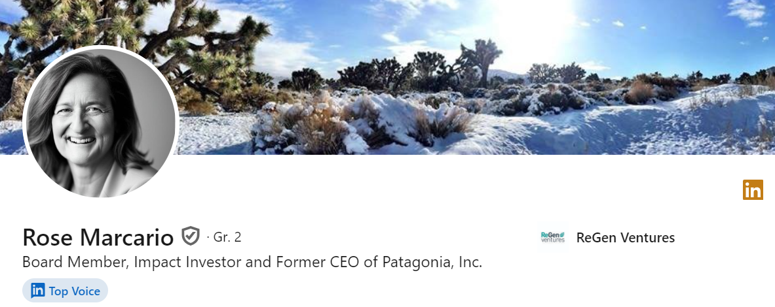
Intro
“Business doesn’t live in a vacuum, but in an interconnected world.”
Neither do us
We as stock exchanges have to look at the global context and assess how our strategies fit into it
3

Slide 3

Global context
Mohamed El-Erian - President of Queens’ College, Cambridge and chief economic adviser at the financial giant Allianz
Michael Spence - academic who went from a Nobel prize in economics in 2001 to a position with the private equity firm Oak Hill Capital and a senior fellowship at the free market Hoover Institution
Gordon Brown - former prime minister of Great Britain who hosted the G20 summit in London at the height of the crisis in March 2009, convincing the gathered powers to “flood financial markets with cash”
3

Slide 4
Global context – what do they say? (2023)
Long term trends:
“We are moving from an unipolar world to a multipolar one”, from “neoliberalism to neonationalism, from “hyper-globalization to fragmentation”;
Inflation – central banks “risk winning the inflation war but losing the peace by tanking the economy”;
Growth is not just slowing but changing as supply chains are expensively reconfigured (giving birth to notions like “friend-shoring”, “near-shoring” and “reshoring”)
3

Slide 5
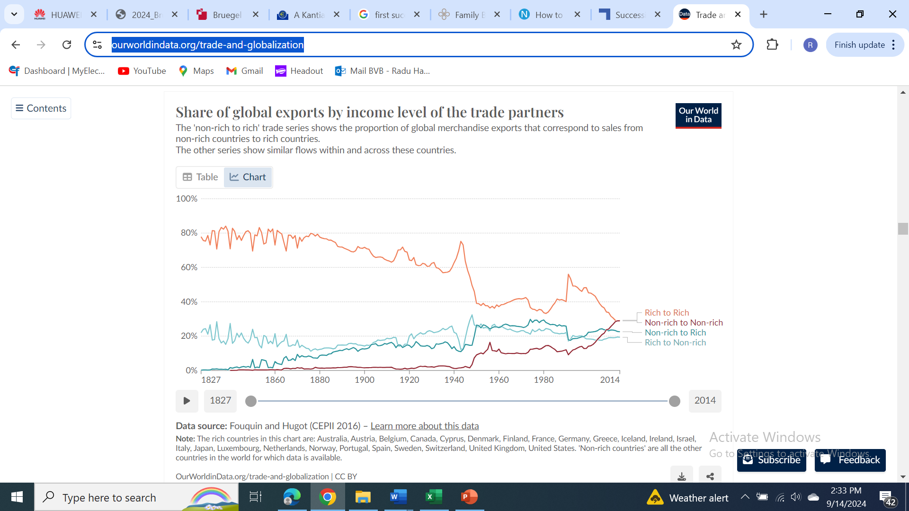
Global trade: the growth of Emerging Markets
Source: https://ourworldindata.org/trade-and-globalization
3

Slide 6
How do we fit?
3

Slide 7
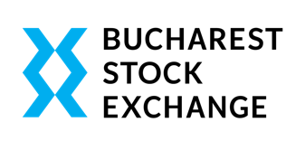
How do we fit in the picture? – the most important strategic pillars
BVB – positioning as the main financing channel for the Romanian companies;
Broadening the (local and international) investor base;
Maintaining a modern trading and post-trading infrastructure;
Education and support for the capital market ecosystem: issuers, intermediaries and investors;
Profitability at Group level – business sustainability;
3

Slide 8
How did we execute the strategy?
3

Slide 9
1.1 Opportunity – first succession for local FOBs
Learning from other’s experience – US:
- only 30% of family-owned businesses in the U.S. survive into the second generation, 12% into the third, and 3% into the fourth and beyond (SBA);
- Nearly two-thirds of family businesses don’t have a documented and communicated succession plan (PwC’s US Family Business Survey, 2023);
- It’s estimated that only 30% of small businesses successfully sell, leaving 70% of small businesses without a buyer or successful plan for what happens next (Exit Planning Institute);
Opportunity - making the stock exchanges part of the solution for the 70% FOBs who don’t successfully sell;
Growing the retail
investor base
9

Slide 10
1.2 Listings in the Romanian market (#213 / EUR 14bn)
The establishment of the Central Counterparty and the launch of the
derivatives market
Growing the retail
investor base
Improving the financial education of market participants
Source: BVB
10

Slide 11
1.3 Recent significant IPOs…
Hidroelectrica
~20% stake sold in a secondary offer by Fondul Proprietatea in July 2023 for EUR 1.87bn (EUR 9.4bn valuation), largest in Europe and 4th largest worldwide in 2024
Syndicate led by: Citi, Jefferies, Erste Bank and Morgan Stanley
Priced at RON 104 / share vs 94-112 range
Allocations
  20% Retail - 52,000 orders worth EUR 1.2bn – 3.1x oversubscription
  Institutional 80% - 50% domestic & 30% foreign – 109 orders receiving allocations out of ~200 bids submitted & more than 1000 investors across the globe attending company / analyst meetings. Domestic pension funds demand in the EUR 900mn – EUR 1.1bn range
Premier Energy
28.75% stake sold for EUR 140mil in May 2024 (primary + secondary)
Syndicate led by Wood&Co, Citi and Unicredit
Priced at RON 19.5 vs 19-21 range
Allocation
  20% retail – 13,000 orders worth EUR 200mil – 7x oversubscribed
  Solid demand from both domestic and foreign institutions
Attracting more issuers
Growing the retail
investor base
11

Slide 12
1.4 …coupled with strong Index performance in global context…
+97%
+14%
-4%
Source: BVB
12

Slide 13
1.5 …and in regional context…
+171%
+110%
+83%
+80%
+55%
+29%
Source: BVB
13

Slide 14
1.6 …have a significant impact in BVB market cap evolution
GDP & Market capitalization
Source: BVB
14

Slide 15
2.1 Broadening the local retail investor base…
Source: ICF – Investors Compensation Fund
15

Slide 16
2.2 …and the institutional investor base…
# 4.5 million active participants
# 810k investors in open investments funds
EUR 2- 2.5bn yearly net inflows
Equity investments restricted to EU listings. 94% allocation to locally listed issuers
Domestic indices ETFs are the fastest growing category. Current AuM EUR 93.5mn EUR, +6.4x since end-2022
16

Slide 17
2.3 …give a boost to liquidity…
Source: BVB
17

Slide 18
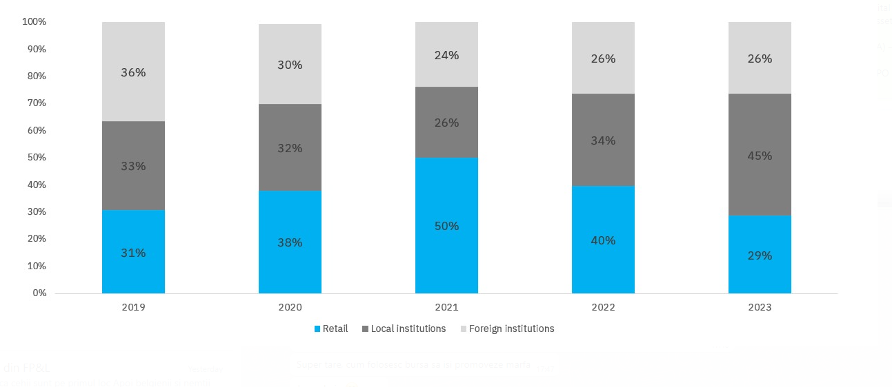
2.4 …with trading activity tilting towards local investors
Source: BVB
18

Slide 19
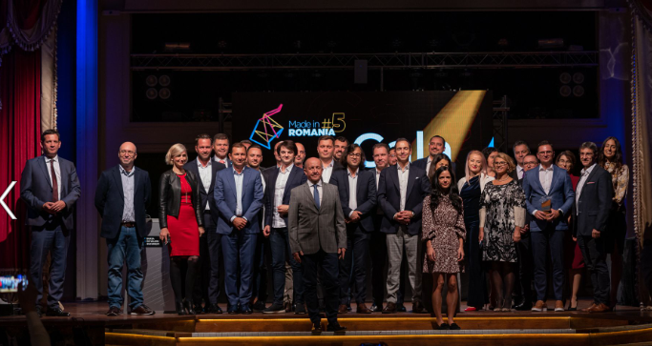

Significant projects – looking to the future
- The Romanian Government approved in May 2023 the Strategy for the Development of the Capital Market, prepared with the support of OECD;
- The Romanian Government approved in June 2024 an incentive scheme for new capital raisings through the stock exchange for private companies, covering up to EUR 300k of the listing costs;
- BVB Arena program dedicated to local entrepreneurs and aimed at identifying and promoting the most promising locally owned businesses celebrates its 7th edition in 2024.
- BVB Research Hub (www.bvbresearch.ro) project supports the local retail investors by providing access to Research Reports, Peer Analysis, ESG Data and Contributors (+340 reports published since launch)
19

Slide 20
Going forward…
…more of the same:
Positioning the stock exchange as the main supporter and partner for the local companies;
Attracting the local retail investors by increasing the visibility, credibility and accessibility of the market;
Promoting regional cooperation among stock exchanges;
Increasing the visibility of the Romanian market to foreign investors;
20

Slide 21
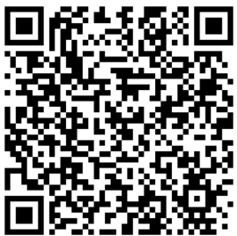
Scan the QR code for the presentation …
21

